Slide 1
Introduction To Cloud Computing With Microsoft Azure.
Tashik Moin MLSA, Microsoft. Tashik.Moin@StudentAmbassadors.Com
References Microsoft Ignite Microsoft Learn MSDN
Notes:
Good morning! I'm [ YOUR NAME ] and I'm absolutely thrilled to join you in [ CITY YOU ARE IN ].
Azure provides compute, storage and networking for the cloud
If you're new to Azure, or the cloud, it can be intimidating
This session will cover the essential concepts you'll need to get off and running with Azure networking

Slide 2

The idea of an “intergalactic computer network” was I The idea of an “ Intergalactic Computer Network Or Cloud Computing ” was introduced in the 1960s by, JCR LICKLIDER.

Slide 3
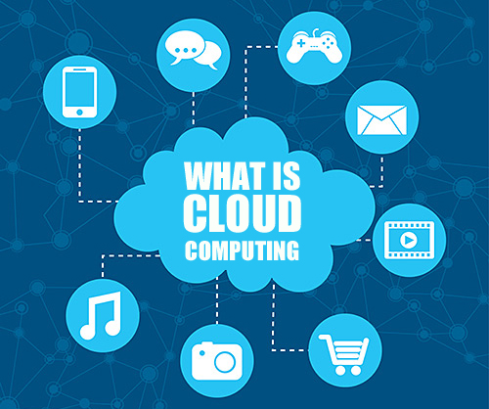

Slide 4
What is Cloud Computing ?
Cloud computing is the on-demand availability of computer system resource, especially data storage (Cloud Storage) and computing power, and other IT services without direct active management by the user; Cloud Computing is a way to rent compute power and storage from someone else's data center. The cloud services are provided using the Internet with the pay-as-you-go pricing model.

Slide 5
Expenses For A Business Before Cloud ?
Capital Expenditure (CapEx)
- CapEx is the spending of money on physical infrastructure up front, and then deducting that expense from your tax bill over time. CapEx is an upfront cost, which has a value that reduces over time.
- It includes Server costs, Storage costs, Network costs, Backup costs, Disaster recovery costs, Datacenter Infrastructure (Router, Switches, Cables etc.) costs etc.
- Lump-sum billing.
Operational Expenditure (OpEx)
- OpEx is spending money on services or products now and being billed for them now. You can deduct this expense from your tax bill in the same year. There's no upfront cost. You pay for a service or product as you use it.
- It includes Management Cost ( Employees Salary ), 24/7 Electricity Usage,
Scaling charges, Equipment Refreshment etc.
- Monthly / Annual billing

Slide 6
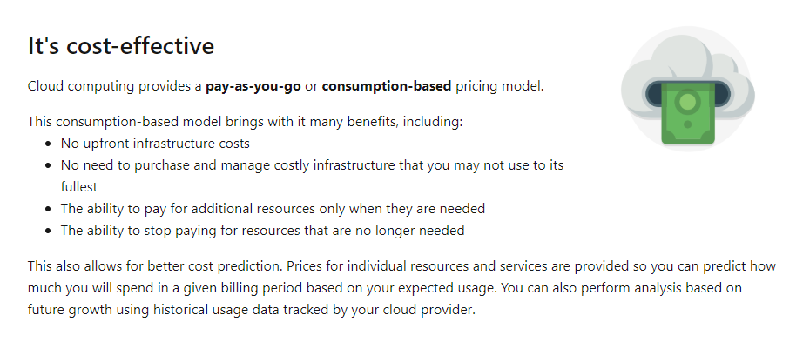

Slide 7
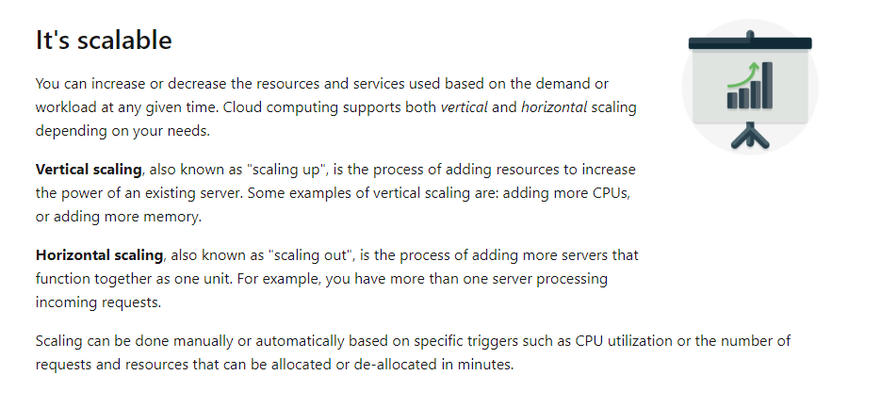

Slide 8
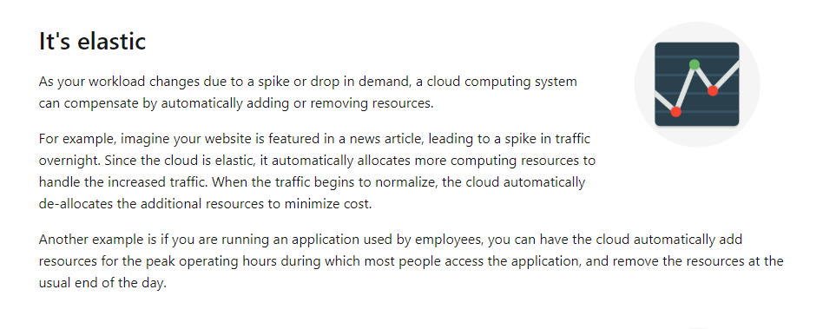

Slide 9
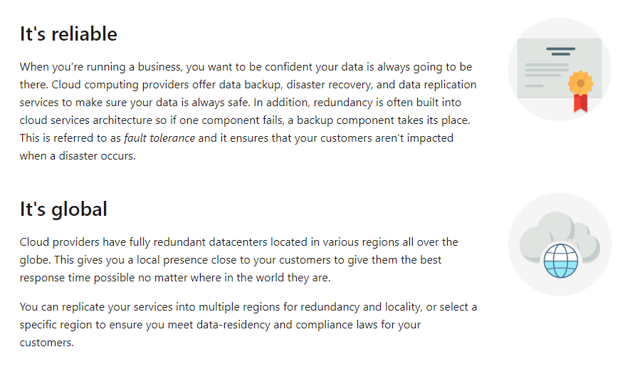

Slide 10
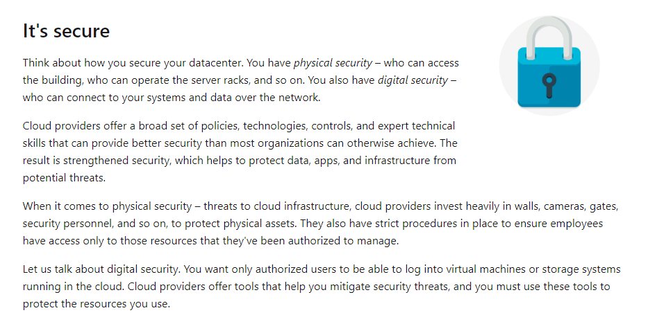

Slide 11
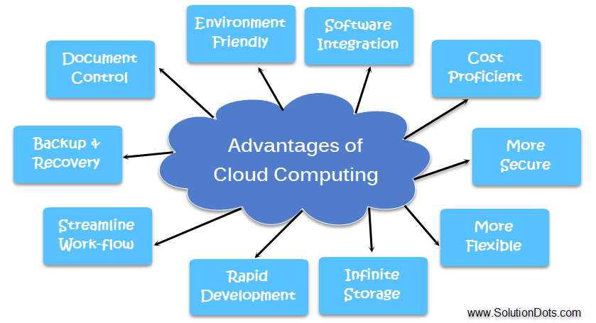

Slide 12
How We Are Connected With The Cloud ?

Slide 13
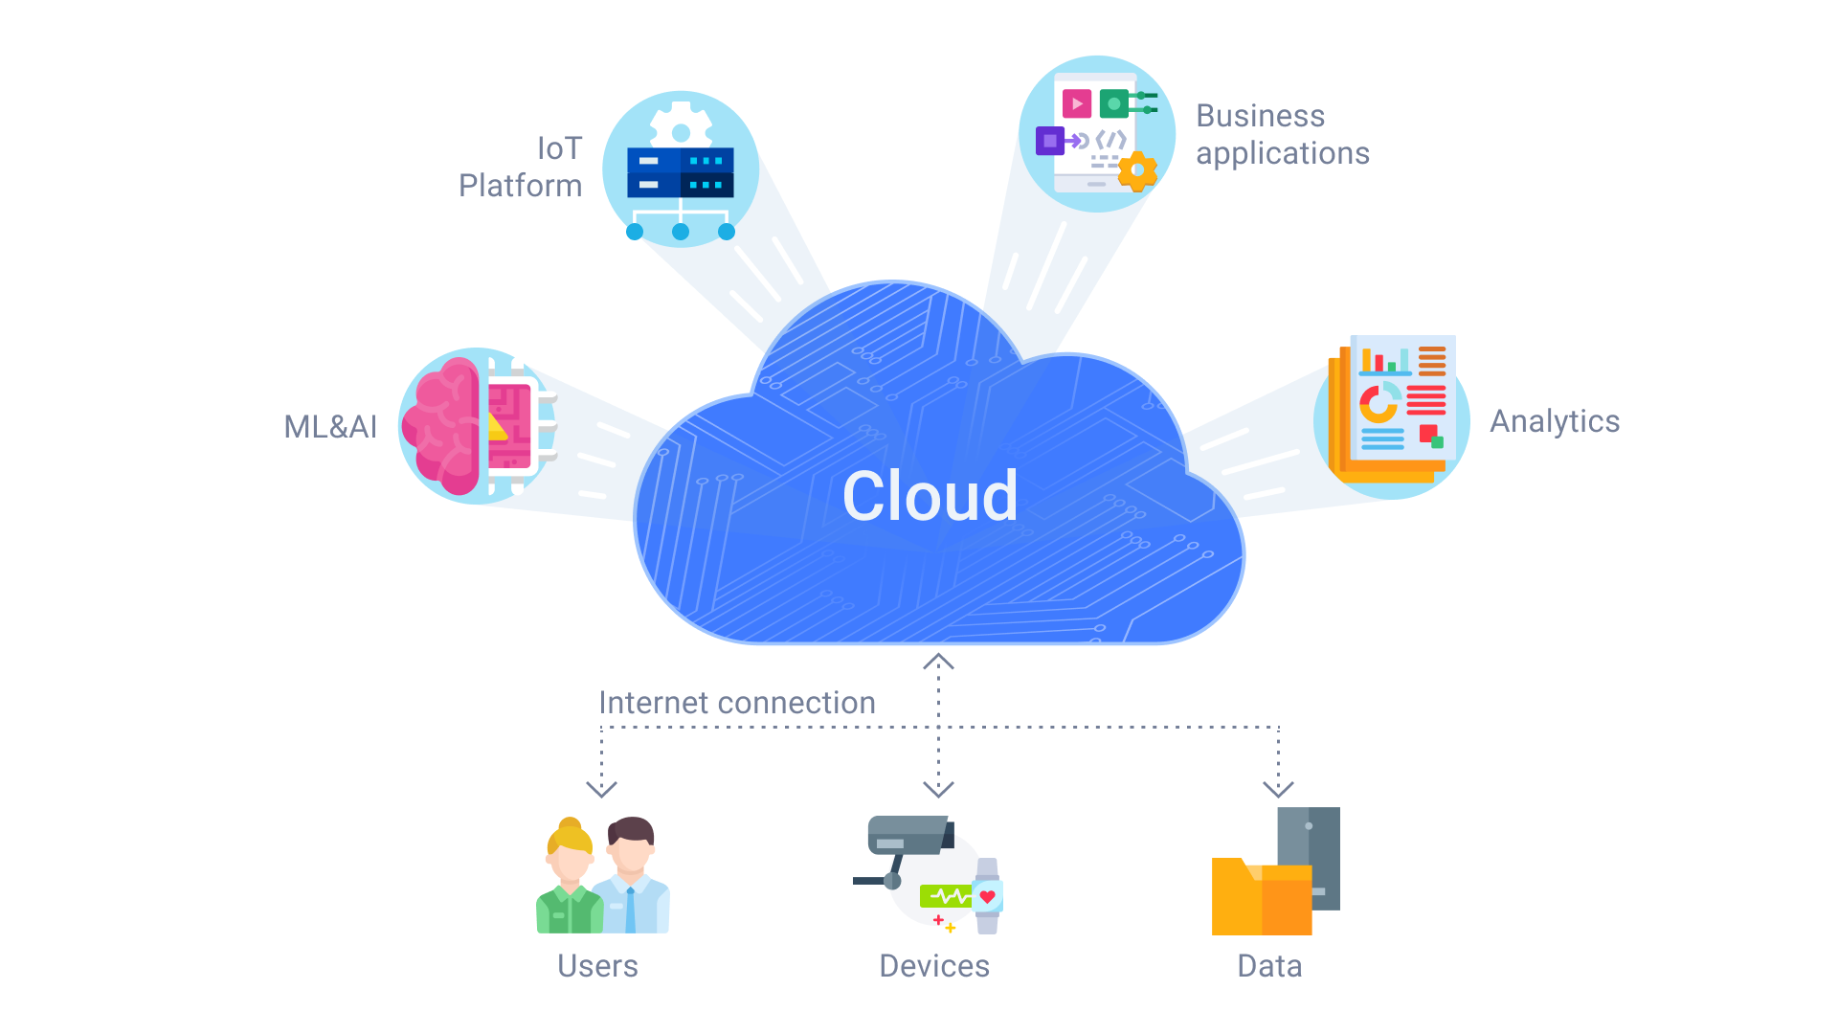

Slide 14
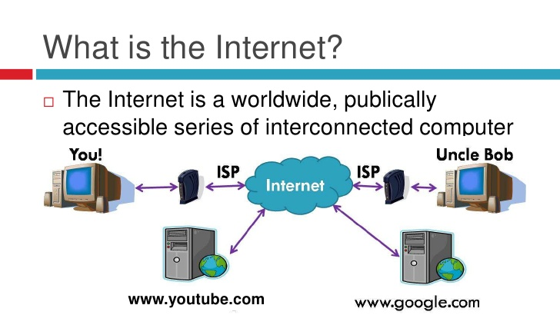

Slide 15
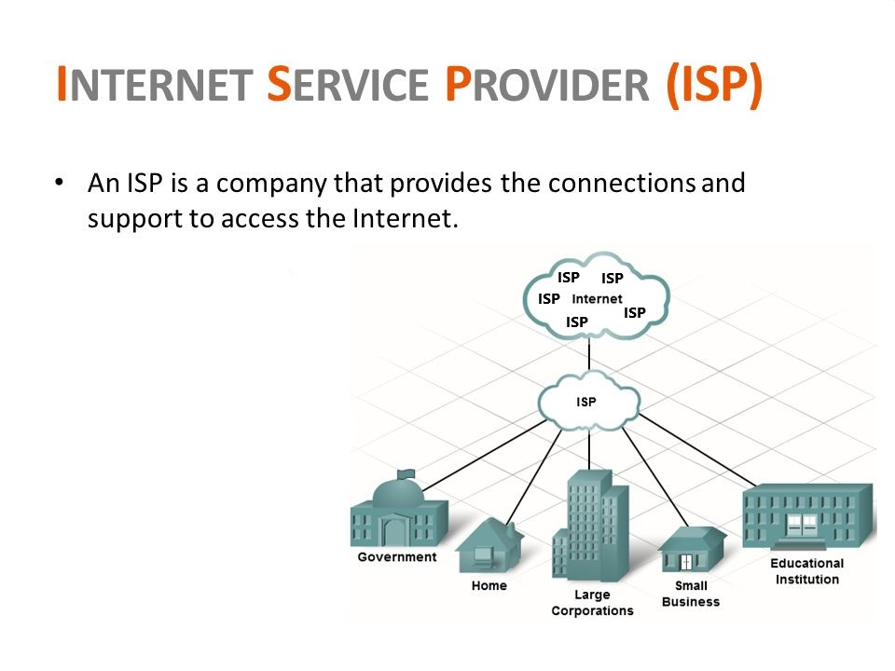

Slide 16
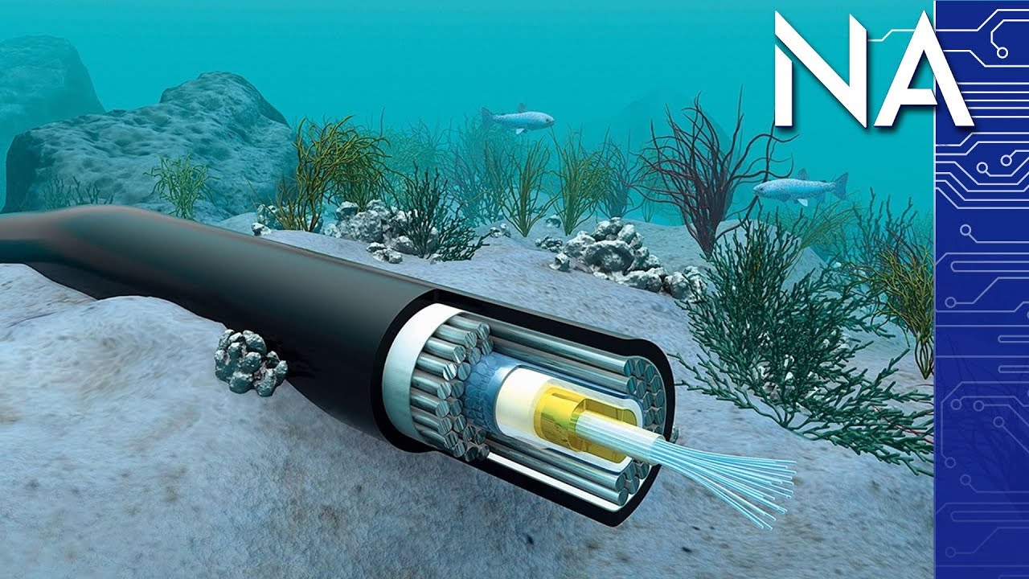

Slide 17



Slide 18
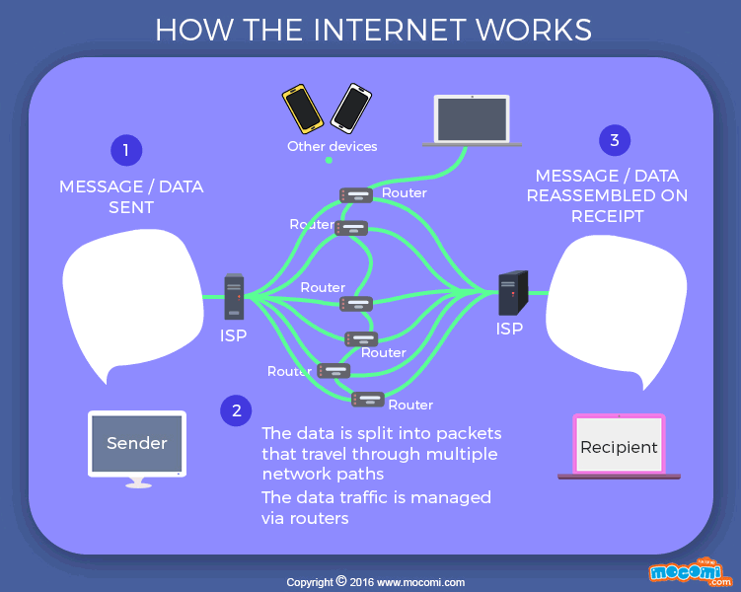

Slide 19
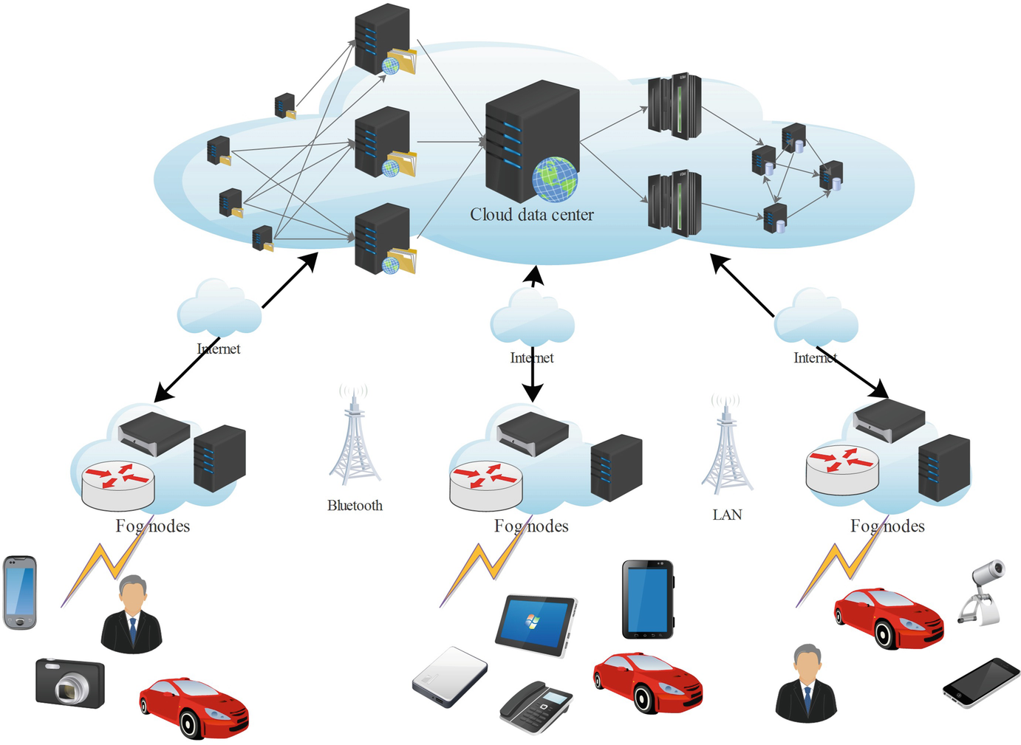

Slide 20
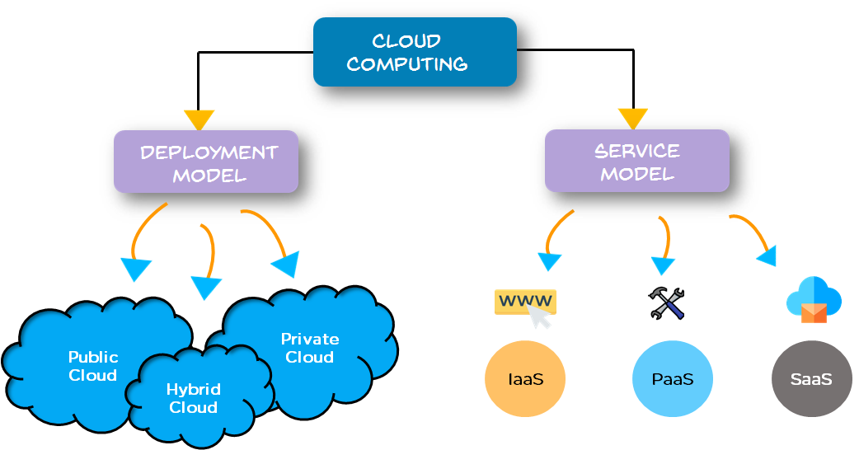

Slide 21
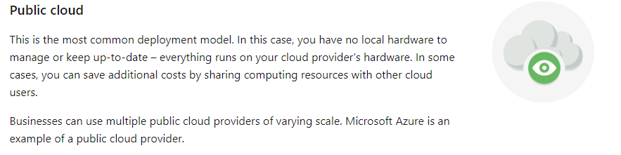
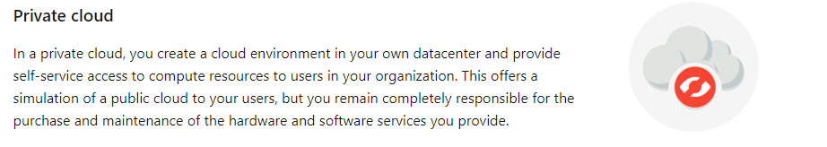

Slide 22
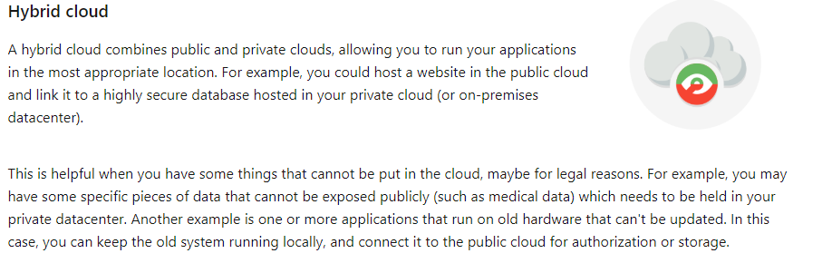

Slide 23
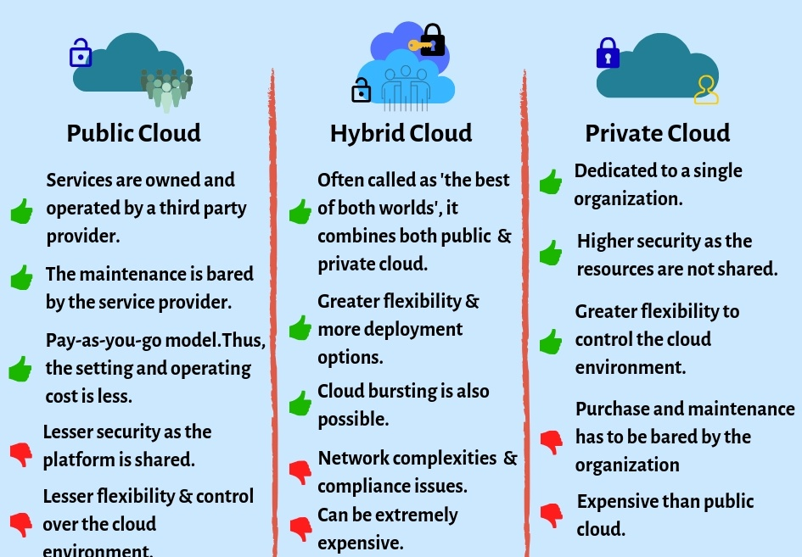

Slide 24
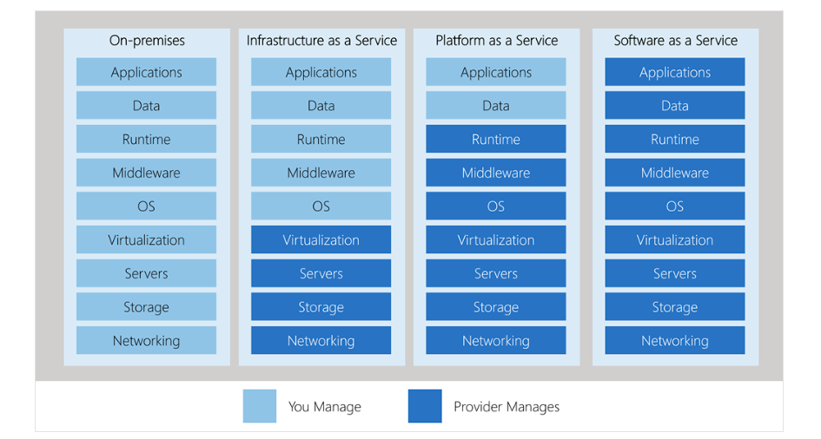

Slide 25
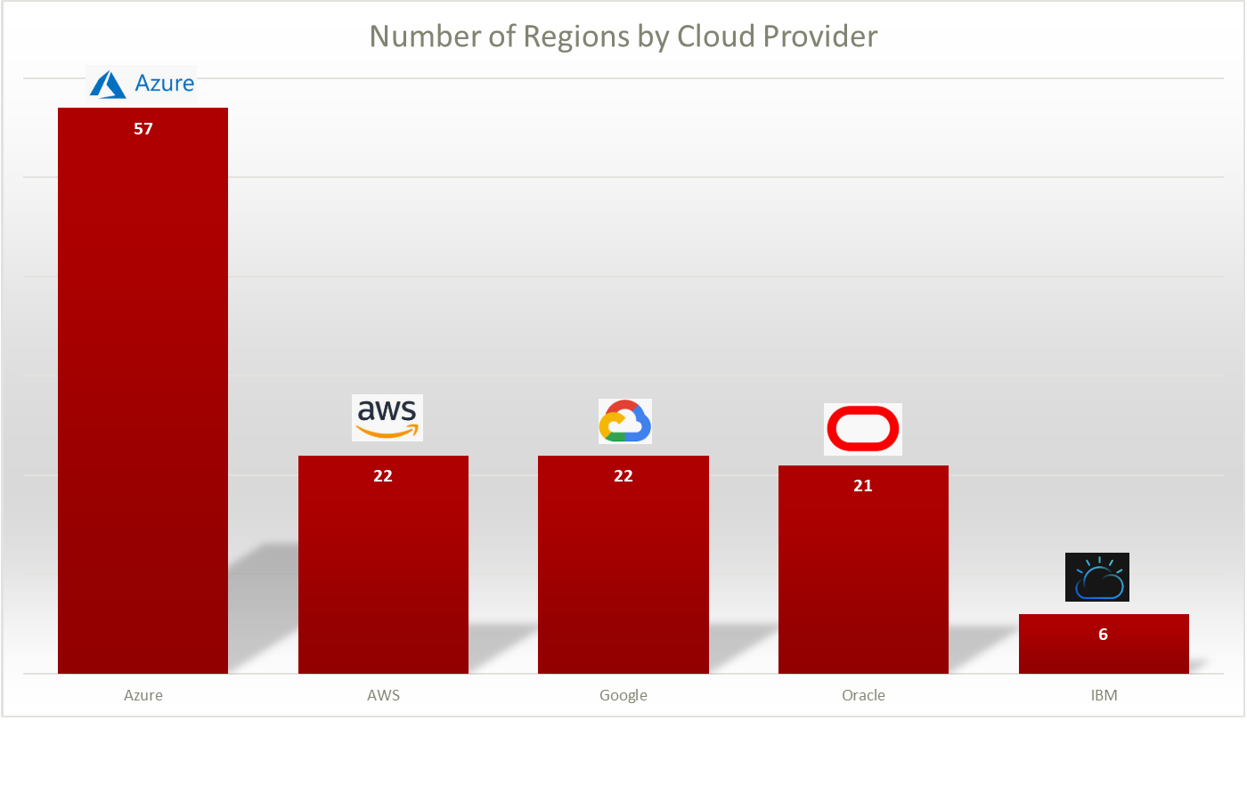
160+
78+
20+
Total Data Centers

Slide 26
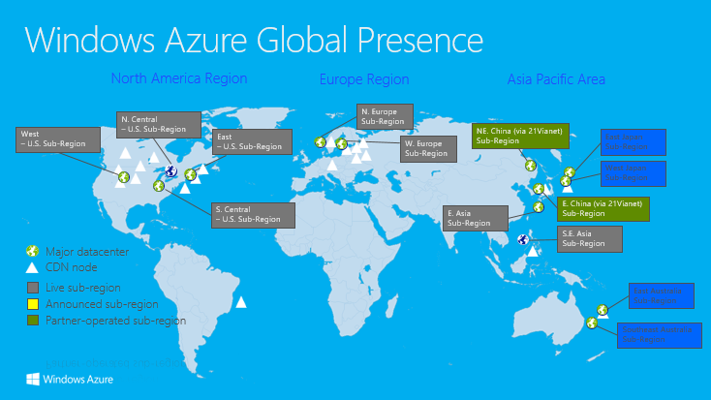
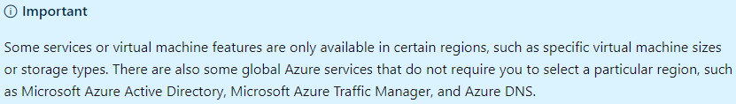

Slide 27
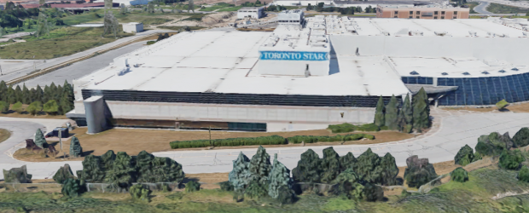
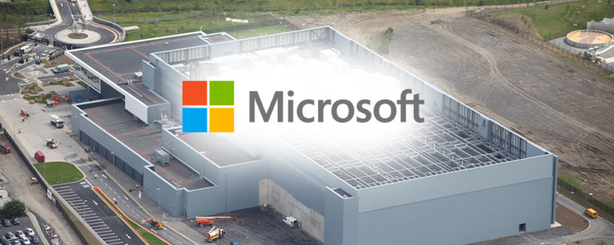
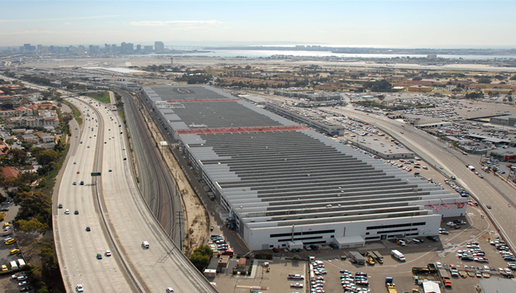
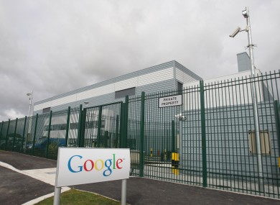
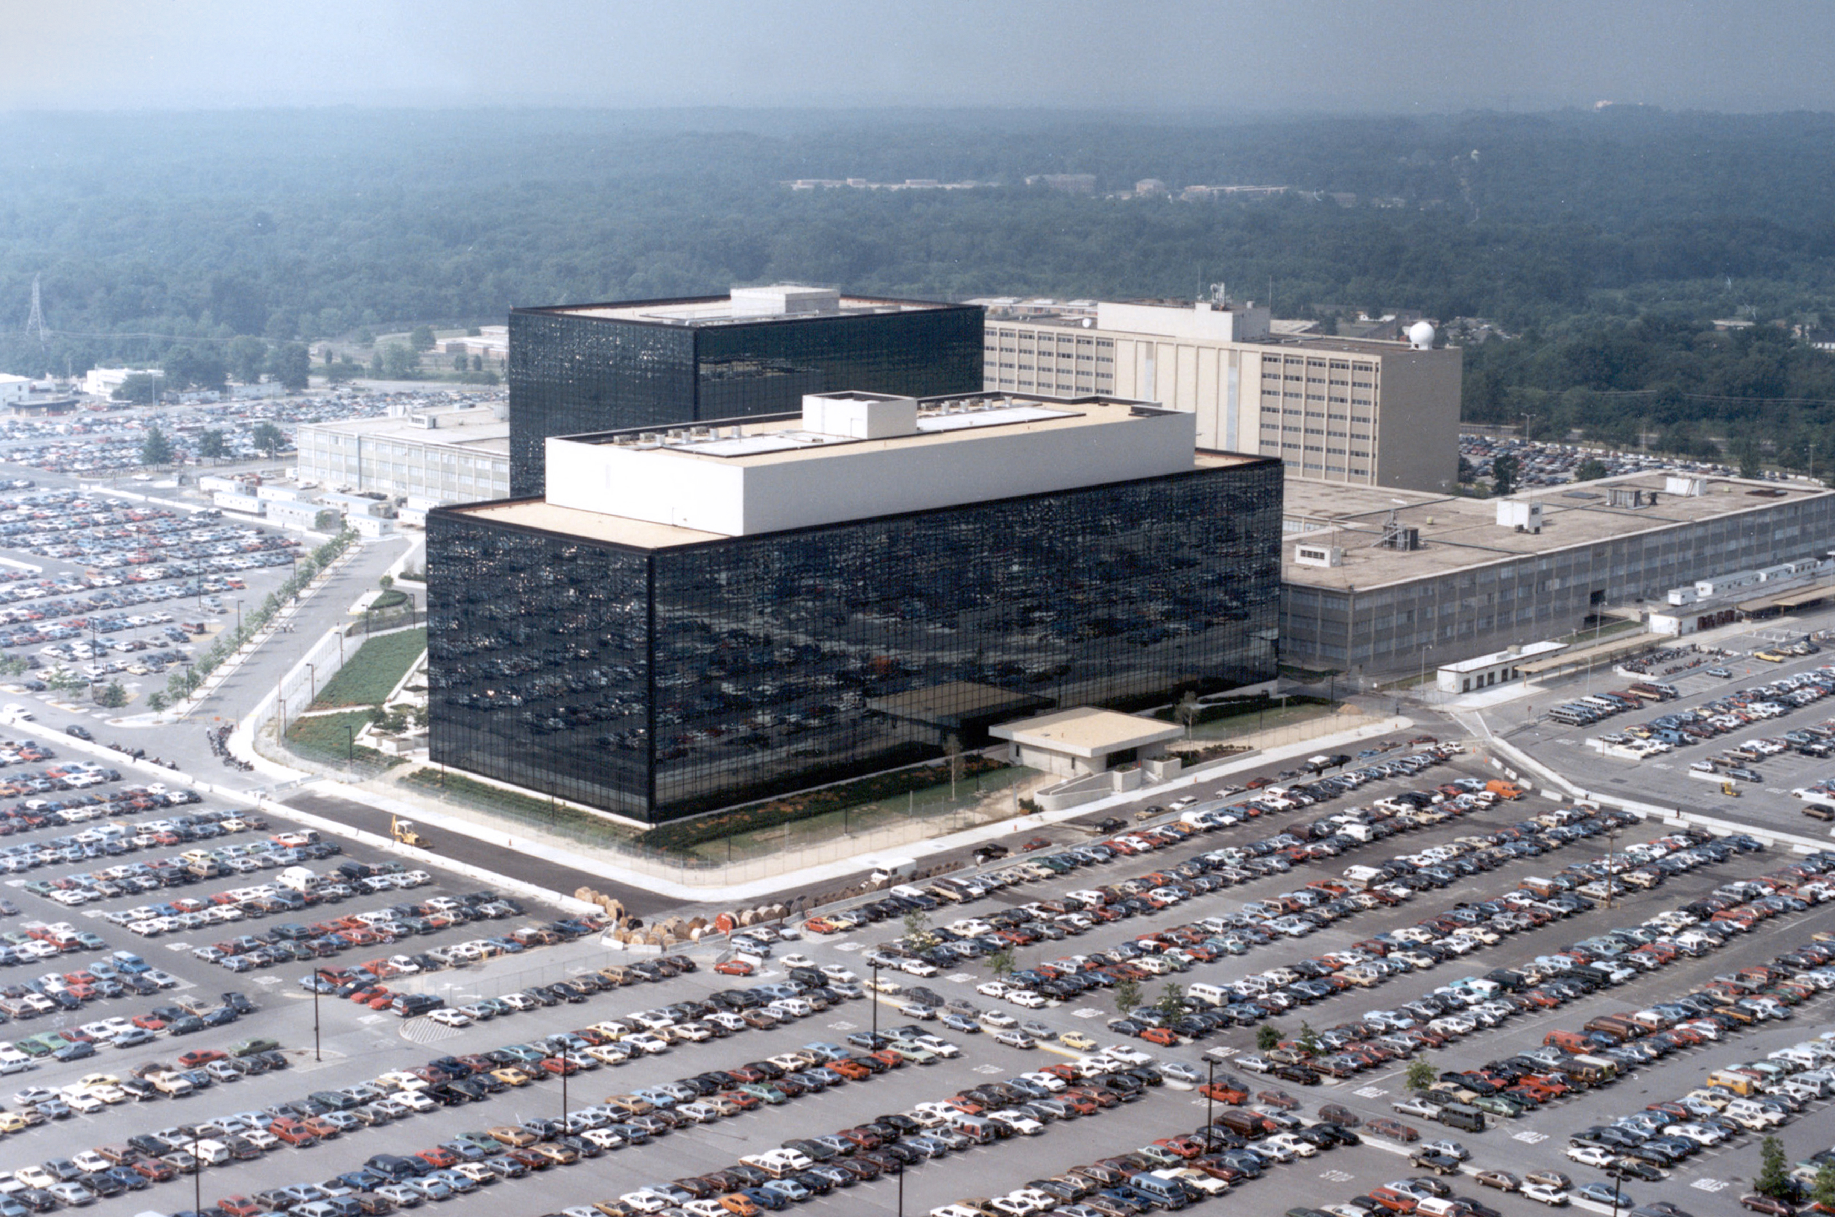
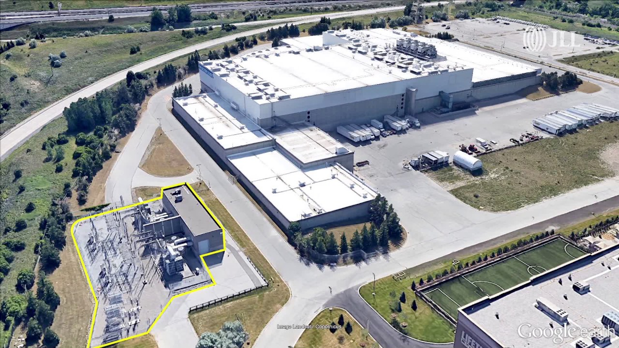

Slide 28
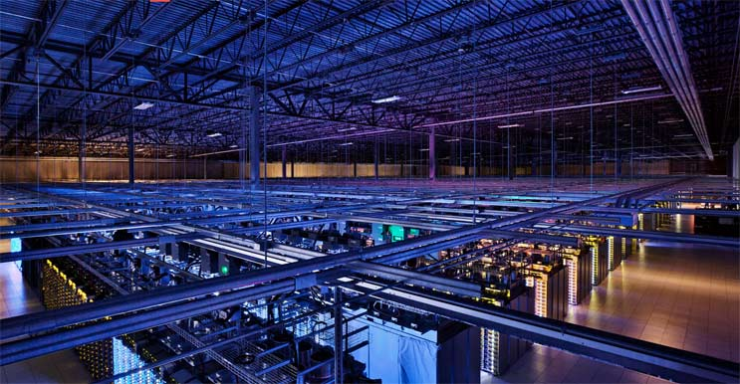
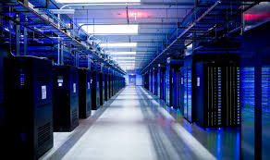
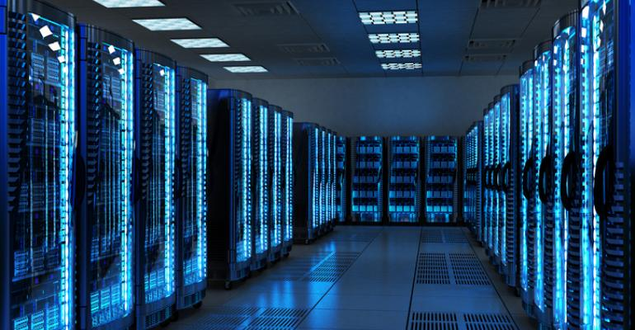
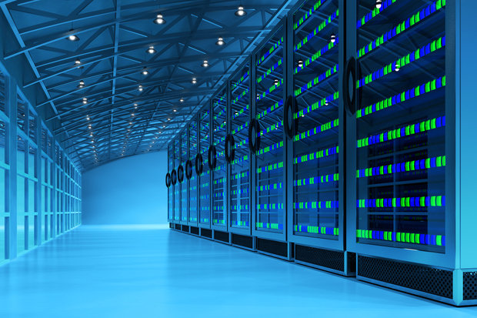

Slide 29
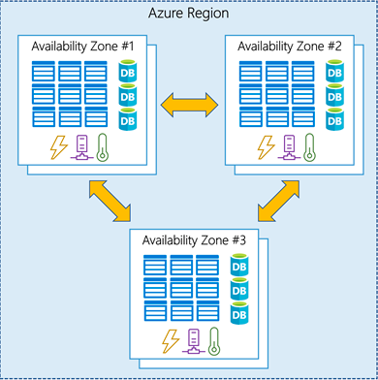
What Are Availability Zones ?
An Availability Zone is a high-availability offering that protects your applications and data from datacenter failures. Availability Zones are unique physical locations within a region. Each zone is made up of one or more datacenters equipped with independent power, cooling, and networking.
List Of Supported regions In Microsoft Azure
Not every region has support for Availability Zones. The following regions have a minimum of three separate zones to ensure resiliency.
- Central US
- East US 2
- West US 2
- West Europe
- France Central
- North Europe
- Southeast Asia

Slide 30
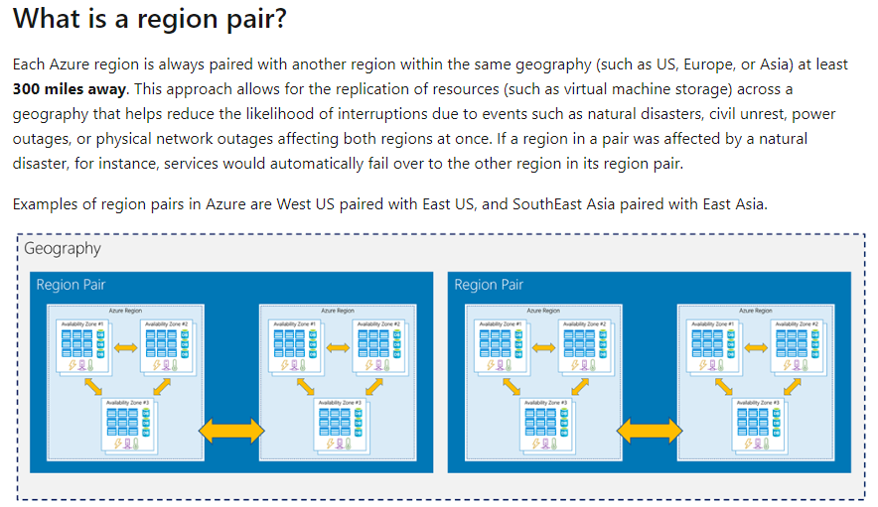

Slide 31
Computing Options In Cloud ?
Virtual Machines
Containers
Serverless Computing

Slide 32
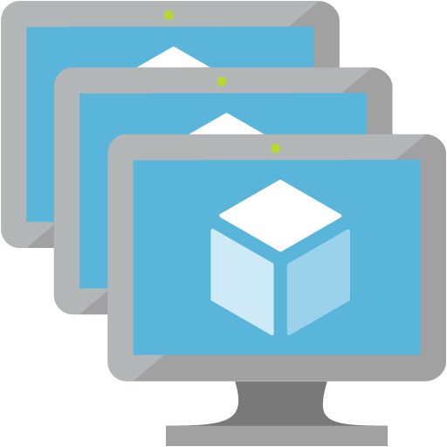
Virtual Machines
Definition
Virtual machines are software computers that provide the same functionality as physical computers. Like physical computers, they run applications and an operating system. However, virtual machines are computer files that run on a physical computer and behave like a physical computer. In other words, virtual machines behave as separate computer systems.
Types Of Virtual Machines Process Virtual Machines Execute computer programs in a platform-independent environment. It masks the information of the underlying hardware or operating system. This allows the program to be executed in the same fashion on any platform. Example : JVM, .NET Core CLR etc.
System Virtual Machines
Support the sharing of a host computer’s physical resources between multiple virtual machines.
Example : Virtual Machines Created From VMware.

Slide 33
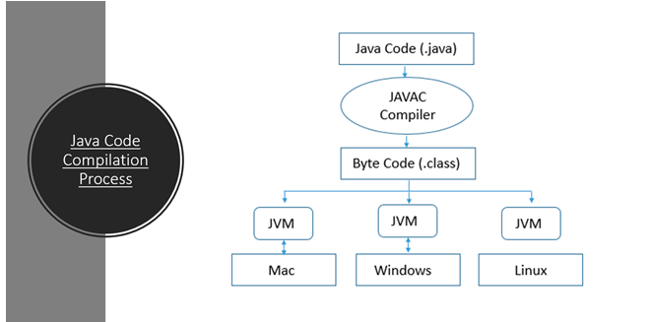

Slide 34
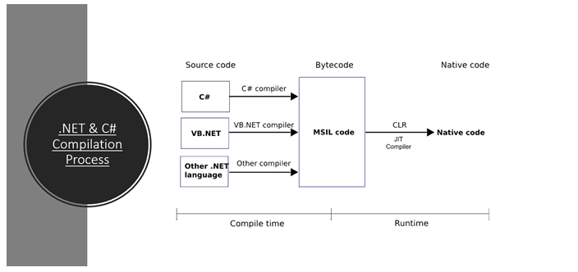

Slide 35
